Slide 1
DoD Enterprise DevSecOps Initiative (Software Factory)
Mr. Nicolas Chaillan
Chief Software Officer, U.S. Air Force
Co-Lead, DoD Enterprise DevSecOps Initiative
v1.6 – UNCLASSFIED

Slide 2
Problem Statement
What is DevSecOps?
The software automated tools, services, and standards that enable programs to develop, secure, deploy, and operate applications in a secure, flexible and interoperable fashion.
Why should I care?
Software and cybersecurity pervades all aspects of DoD's mission (from business systems to weapons systems to Artificial Intelligence to cybersecurity to space) - establishing DevSecOps capabilities will:
Deliver applications rapidly and in a secure manner, increasing the warfighters competitive advantage
Bake-in and enforce cybersecurity functions and policy from inception through operations
Enhance enterprise visibility of development activities and reduce accreditation timelines
Ensure seamless application portability across enterprise, Cloud and disconnected, intermittent and classified environments
Drive DoD transformation to Agile and Lean Software Development and Delivery
Leveraging industry acquisition best practices combined with centralized contract vehicle for DevSecOps tools and services will enable rapid prototyping, real-time deployments and scalability.
We cannot be left behind: China, Russia and North Korea are already massively implementing DevOps.

Slide 3
Problem Statement
The Department of Defense (DoD) is mostly still using Waterfall software methodologies with software delivery every 3 to 10 years, making it impossible to keep up with the pace of technology.
The DoD Authority to Operate (ATO) process to accredit software takes on average 8 months and is mostly manual with several testing and cybersecurity gates.
Most of the Defense Industrial Base (DIB) (the DoD contractors and developers) have not adopted an Agile and/or DevOps mindset.
Massive organization with large silos and large workforce.
Limited Talent pool, IT enterprise services, Cloud access and high speed connectivity.

Slide 4
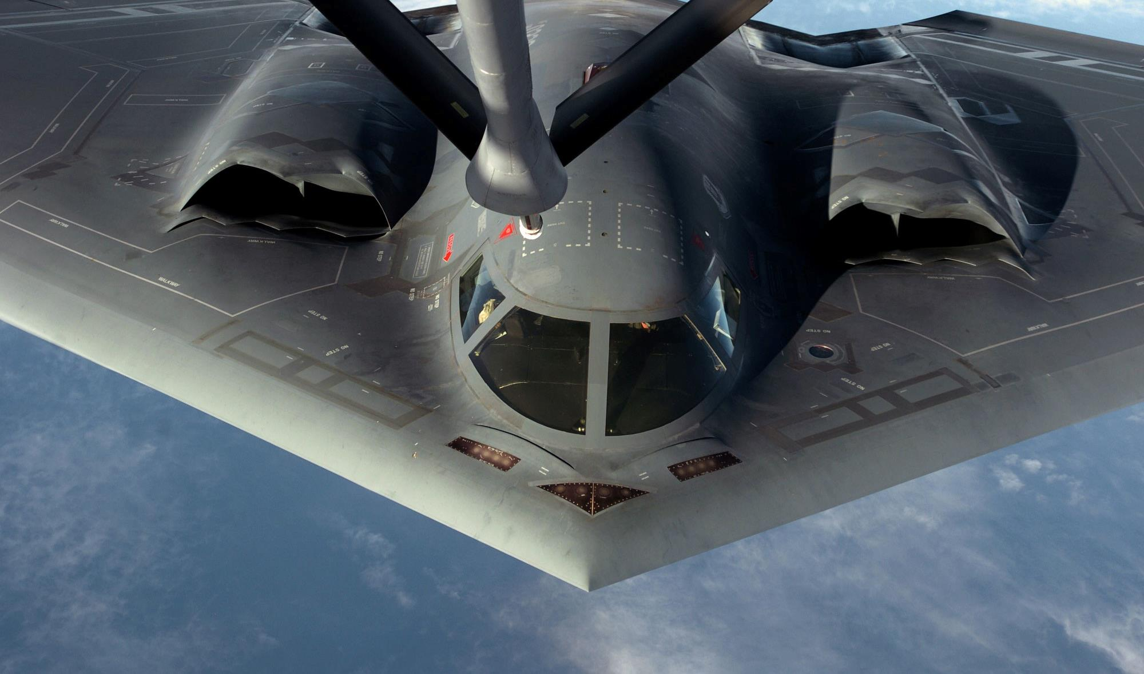
Must Adapt to Challenges
Must Rapidly Adapt To Challenges

Slide 5
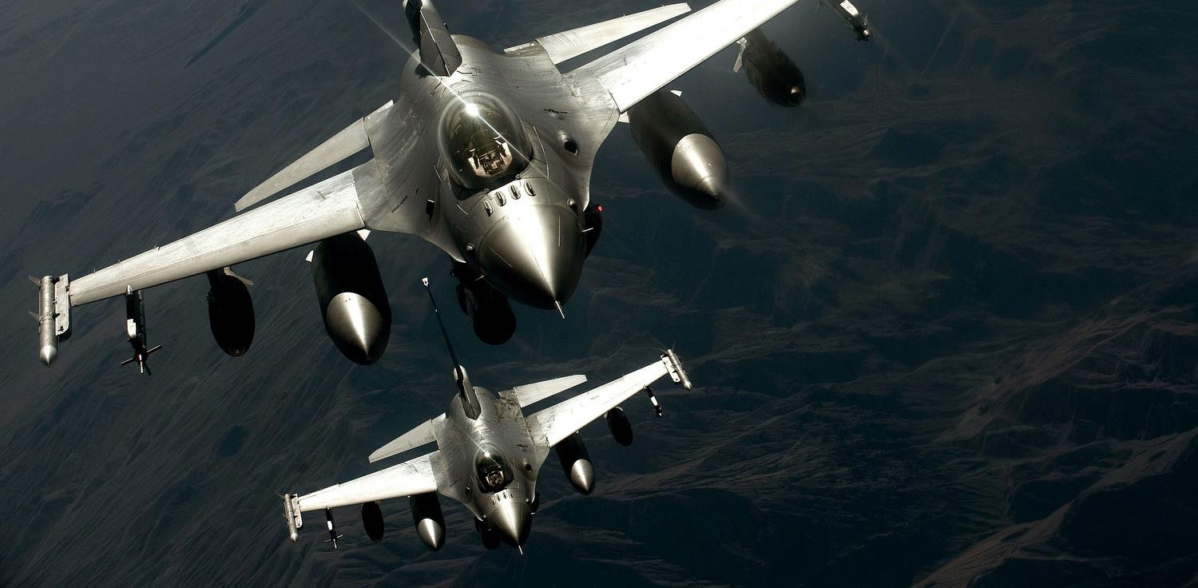
Must Adapt to Challenges
Work as a Team!
Must Adapt To Challenges

Slide 6
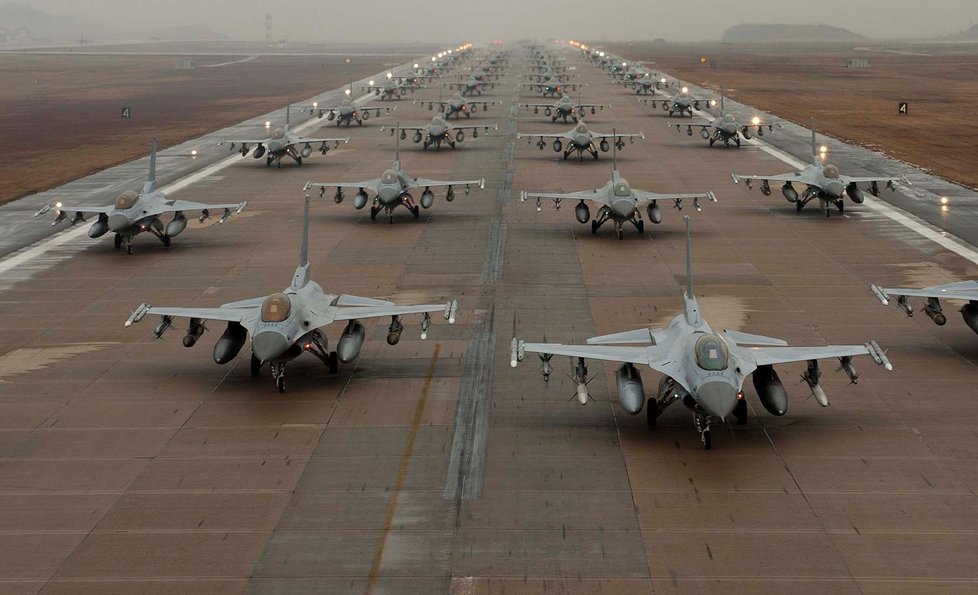
Must Adapt to Challenges
Work as a Team!
A Large Team!
Must Adapt To Challenges

Slide 7
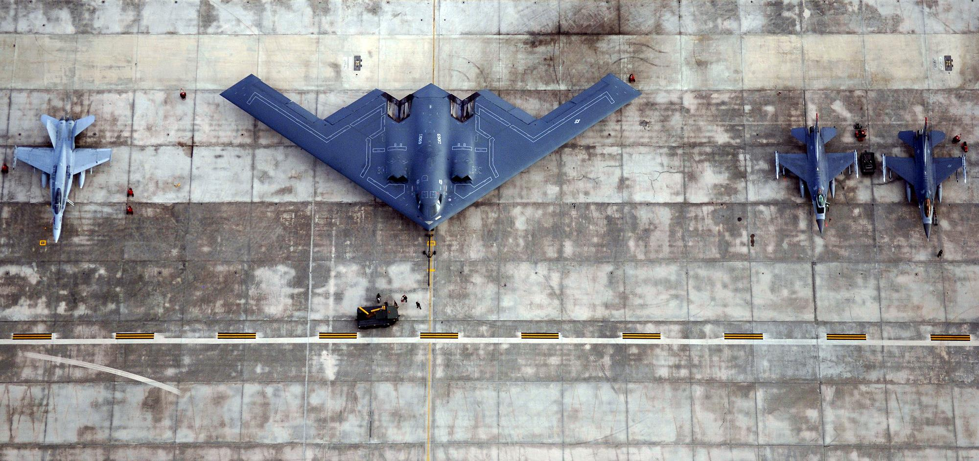
Must Adapt to Challenges
Work as a Team!
With Various Technologies
A Large Team!
Must Adapt To Challenges

Slide 8
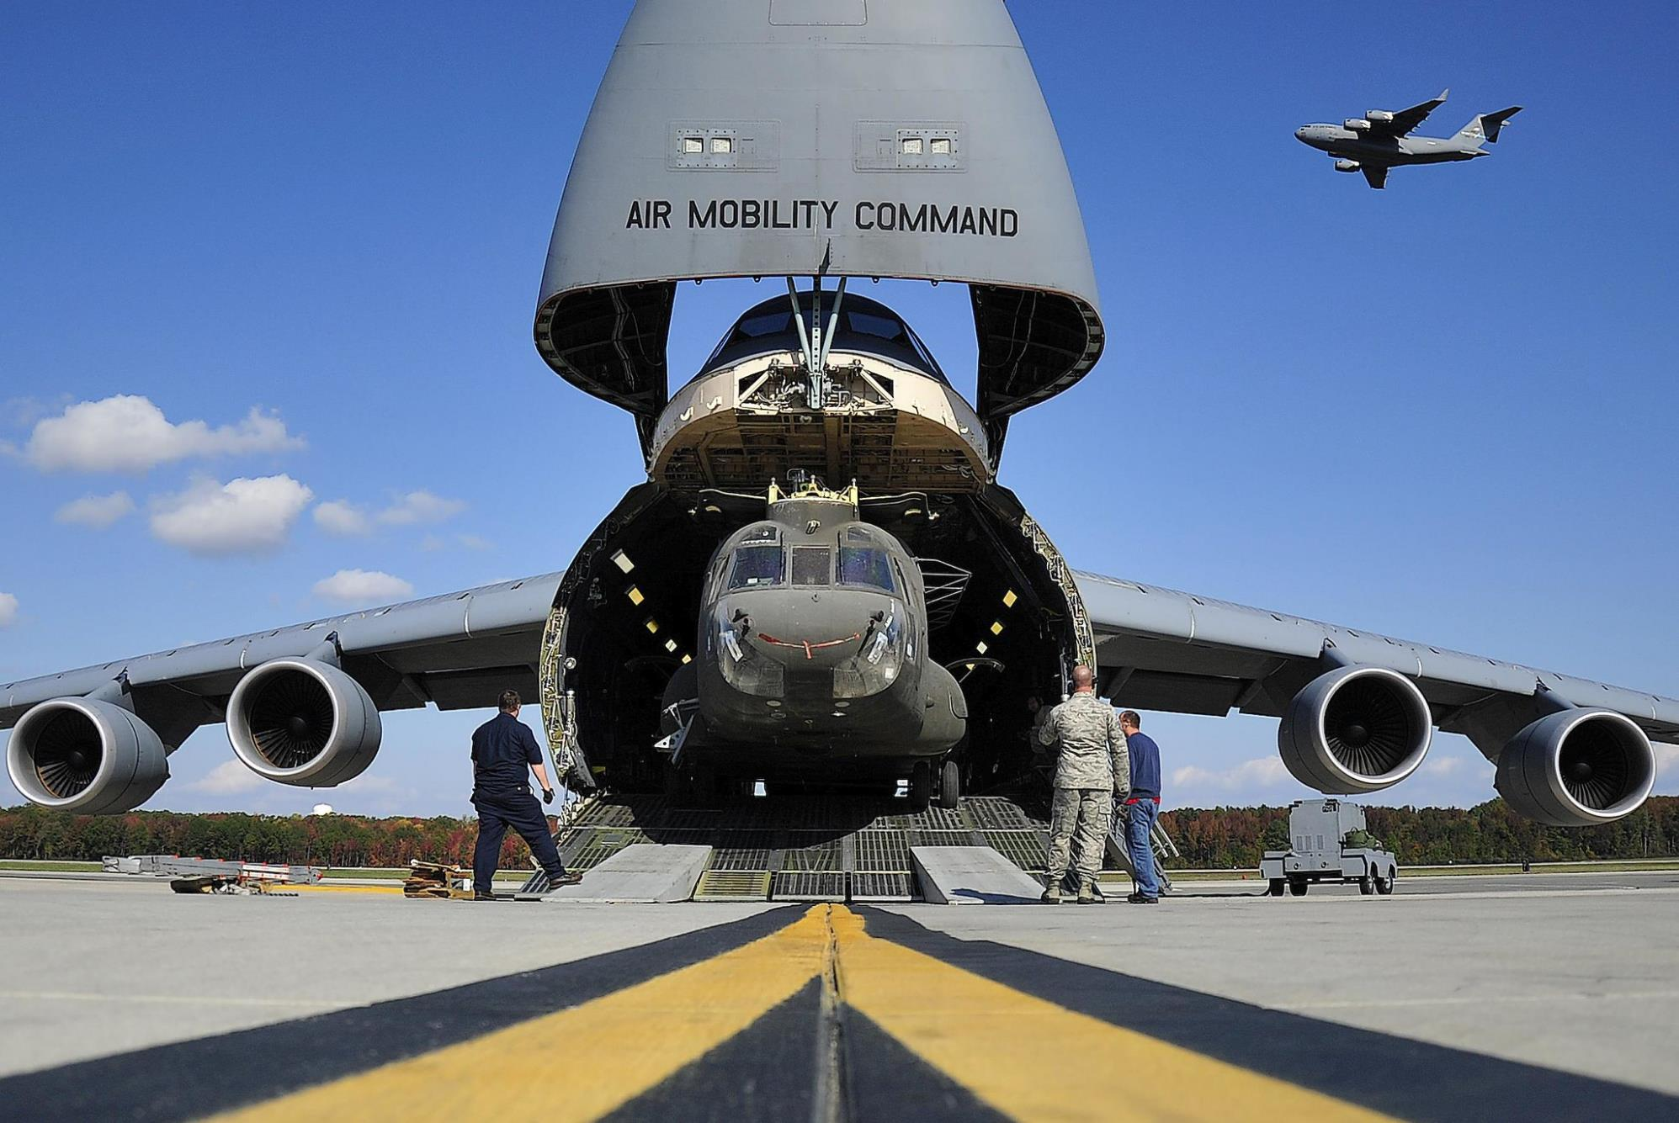
Must Adapt to Challenges
With Various Technologies
Work as a Team!
A Large Team!
Must Adapt To Challenges
Bring It With Us!

Slide 9

Must Adapt to Challenges
With Various Technologies
Work as a Team!
Even To Space!
A Large Team!
Must Adapt To Challenges
Bring It With Us!

Slide 10

Must Adapt to Challenges
With Various Technologies
Work as a Team!
To Space!
A Large Team!
Must Adapt To Challenges
With a Few Sensors!
Bring It With Us!

Slide 11
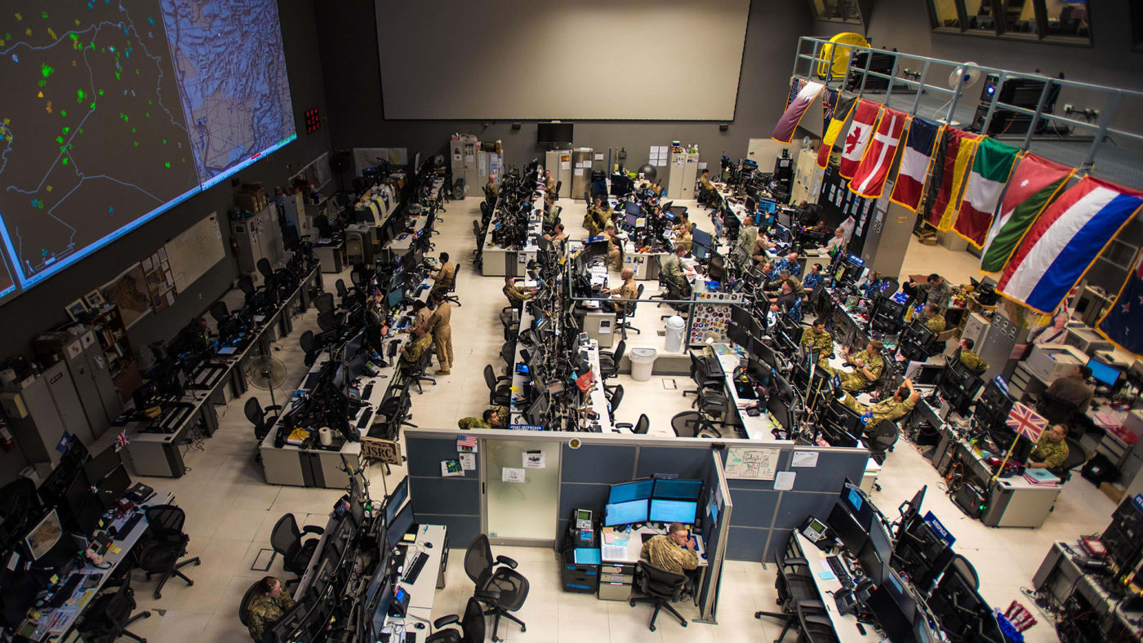
Must Adapt to Challenges
With Their Help!
With Various Technologies
Work as a Team!
To Space!
A Large Team!
Must Adapt To Challenges
With a Few Sensors!
Bring It With Us!

Slide 12
What is the DoD Enterprise DevSecOps Initiative?
Joint Program with OUSD(A&S), DoD CIO, U.S. Air Force, DISA and the Military Services.
Technology:
Avoid vendor lock-in at the Infrastructure and Platform Layer by leveraging FOSS with Kubernetes and OCI containers,
Creating the DoD Centralized Artifacts Repository (DCAR) of hardened and centrally accredited containers: selecting, certifying, and securing best of breed development tools and software capabilities (over 170+ containers) - https://dccscr.dsop.io/dsop/ and https://dcar.dsop.io
Baked-in Zero Trust Security with our Sidecar Container Security Stack (SCSS) leveraging behavior detection, zero trust down to the container/function level.
Leveraging a Scalable Microservices Architecture with Service Mesh/API Gateway and baked-in security (Istio)
Leveraging KNative to avoid lock-in to Cloud provider Serverless stacks
Bringing Enterprise IT Capabilities with Cloud One and Platform One – Cloud and DevSecOps as Managed Services capabilities, on-boarding and support!
Standardizing metrics and define acceptable thresholds for DoD-wide continuous Authority to Operate
Massive Scale Training with Self Learning Capabilities (train over 100K people within a year) and bring state of the art DevSecOps curriculum
Creating new Agile contracting language to enable and incentivize the use of DevSecOps

Slide 13
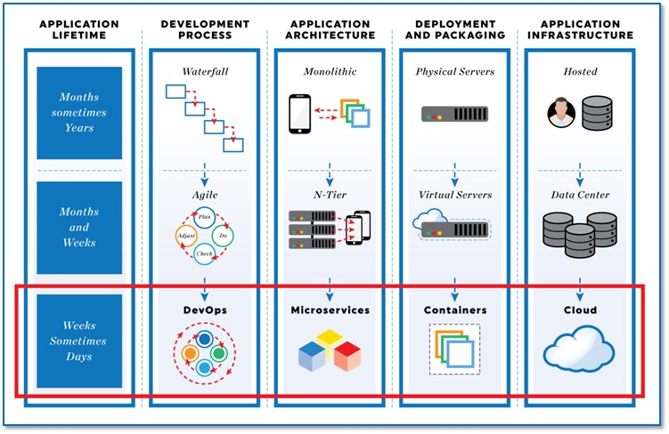
From Waterfall to DevSecOps

Slide 14
Value for DoD Programs
Enables any DoD Program across DoD Services deploy a DoD hardened Software Factory, on their existing or new environments (including classified, disconnected and Clouds), within days instead of a year. Tremendous cost and time savings.
Multiple DevSecOps pipelines are available with various options (no one-size-fits-all)
Enables rapid prototyping (in days and not months or years) for any Business, C4ISR and Weapons system. Deployment in PRODUCTION!
Enables learning and continuous feedback from actual end-users (warfighters).
Enables bug and security fixes in minutes instead of weeks/months.
Enables automated testing and security.
Enables continuous Authorization to Operate (c-ATO) process. Authorize ONCE, use MANY times!
Brings a holistic and baked-in cybersecurity stack, gaining complete visibility of all assets, software security state and infrastructure as code.

Slide 15


“Cloud One” vs “Platform One by LevelUP”
Cloud One:
Centralized team to provide Cloud Infrastructure with baked-in security to DoD programs. Think of it as the Infrastructure team with baked-in security, CSSP and Authority to Operate (ATO).
Platform One by LevelUP:
Centralized team to provide DevSecOps/Software Factory with baked-in security to DoD Programs. Think of it as the Platform Team with the ability to deploy a DevSecOps (Kubernetes compliant) Platform and CI/CD pipeline with a Continuous ATO (c-ATO). You select from accredited tools to accelerate your ability to focus on delivering mission capabilities.

Slide 16

Understanding the DevSecOps Layers
Continuous Monitoring
Leverages the Sidecar Container Security Stack
Development Teams can build software/microservices leveraging hardened containers
YOU
Application
Layer
Brings baked-in security and
Microservices architecture enablement
Platform
One
Service Mesh
Layer
Fully containerized, leverages DoD approved containers from DCAR
Development Team selects tools from 172 approved containers or custom containers
Continuous Integration / Continuous Delivery
(CI/CD) Layer
CNCF compliant Kubernetes (K8S)
Includes Site Reliability Engineers (SREs) etc.
Development Team selects between approved K8S stacks
Platform
Layer
Environment Agnostic
Cloud One Preferred for unclassified (IL2, IL4, IL5)
Or SC2S/C2S/FENCES
Or on-premise/classified environments
Cloud One
Infrastructure
Layer

Slide 17


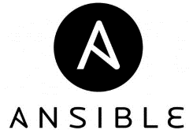
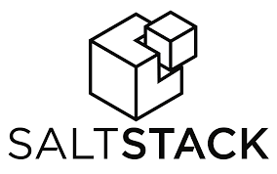








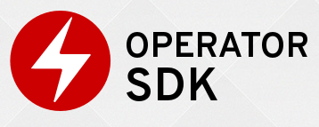





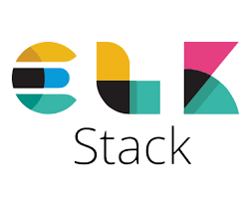






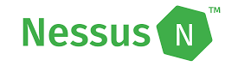

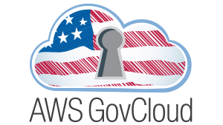










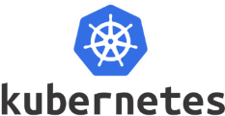



PLAN
&
DEVELOP
DoD Enterprise DevSecOps
Technology Stack
(Exemplar)
DEPLOY
&
OPERATE
BUILD
“Continuous Integration &
Continuous Delivery”
Orchestration
MONITOR
TEST
SECURE
SCALE
STORE ARTIFACTS
Container and Container Management

Slide 18
Sidecar Container Security Stack
Baked-in Zero Trust security down to the Container/Function level with Istio (Envoy) and Knative.
Centralized logging and telemetry with Elasticsearch, Fluentd, Kibana (EFK).
Container security: Continuous Scanning, Alerting, CVE scanning, Behavior detection both in development and production (Build, Registry, Runtime) with Twistlock
Container security and insider threat (custom policies detecting unapproved changes to Dockerfiles) with Anchore
Automated STIG compliance with OpenSCAP

Slide 19
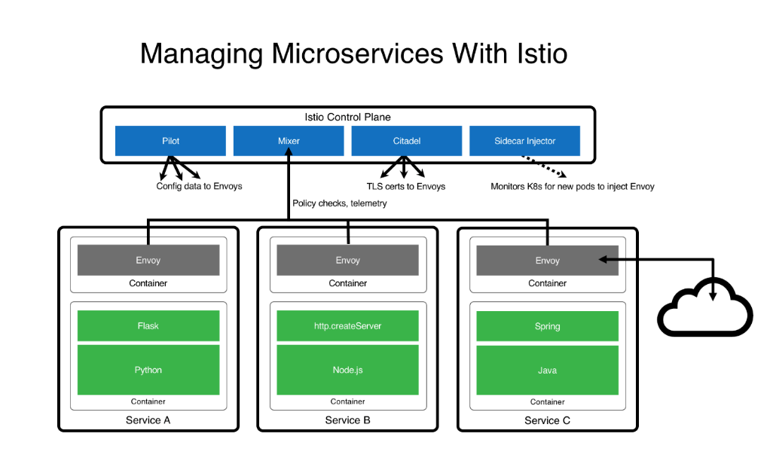
Microservices Architecture (ISTIO)
Turnkey Service Mesh (ISTIO) architecture
ISTIO side car proxy, baked-in security, with visibility across containers, by default, without any developer interaction or code change
Benefits:
API Management, service discovery, authentication…
Dynamic request routing for A/B testing, gradual rollouts, canary releases, resilience, observability, retries, circuit breakers and fault injection
Layer 7 Load balancing
Zero Trust model: East/West Traffic Whitelisting, ACL, RBAC…
TLS encryption by default, Key management, signing…

Slide 20

Cloud One
Air Force Cloud Office with turnkey access to AWS GovCloud and Azure Government at IL2, 4 and 5. IL6 available by December 2019.
Simple “Pay per use” model with ability to instantiate your own Development and Production VPCs at various Impact Levels within days with full compliance/security and a baked-in ATO.
Enterprise Solution: we provide the guardrails to the cloud in a standard manner so you can focus on your mission
Fully Automated: All environmental stand-up is managed by Infrastructure as Code, drastically speeding up deployment, reducing manual work, and human error
Centralized Identities and Single-Sign-On (SSO): one login across the Cloud stack
Internet facing Cloud based VPN to connect to IL5 enclaves with a Virtual Internet Access Point (coming within January 2020).
DevSecOps Focused: secure, mission driven deployments are built into the framework to ensure self-service and seamless deployments. Leverages Zero Trust model.
Proactive Scaling and System Monitoring: Mission Owners can see all operational metrics and provide rules and alerts to manage each mission their way
Accreditation Inheritance has been identified in the AF-Cloud One eMASS accounts (AWS & Azure) to include inheritance from the CSP, USAF, DoD and CSSP. All that’s left for the mission is the controls that are unique to them.

Slide 21
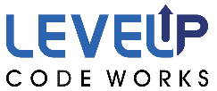
“Platform One by LevelUP” The Air Force Software Factory Team
Merged top talent across U.S. Air Force from various Factories (Kessel Run, SpaceCAMP and UP.
Helps instantiate DevSecOps CI/CD pipelines / Software Factories within days at various classification levels.
Manages Software Factories for Development teams so they can focus on building mission applications.
Provides Blanket Purchase Agreement (BPA) DoD-wide DevSecOps contracts for Cloud Service, Talent and Licenses. Enables awards every 15/30 days with bulk discounts.
Decouples Development Teams from Factory teams with DevSecOps and Site Reliability Engineer (SRE) expertise.
Partners with Cloud One to provide IL2, 4, 5 and 6 access but also uses C2S/SC2S and various on-premise environments!
Self-learning and training capabilities to enable teams move to Scrum/Kanban/eXtreme Programming (XP) Agile practices.
Leverages the DoD hardened containers while avoiding one-size-fits-all architectures.
Fully compliant with the DoD Enterprise DevSecOps Initiative (DSOP) with DoD-wide reciprocity and an ATO. Leverages Zero Trust model.
Hardens the 172 DoD enterprise containers (databases, development tools, CI/CD tools, cybersecurity tools etc.).
Provides Software Enterprise Services with Collaboration tools, Cybersecurity tools, Source code repositories, Artifact repositories, Development tools, DevSecOps as a Service, Chats etc. These services will be MANAGED services on Cloud One.

Slide 22
“Platform One by LevelUP” Managed Services “A La Carte”
Hardened Containers Options
Delivery of hardened enterprise containers with accreditation reciprocity (existing containers only).
Delivery of custom hardened containers as needed.
Continuous Integration / Continuous Delivery (CI/CD) Options
Delivery of existing hardened Kubernetes/OpenShift/PKS playbooks (full Infrastructure as Code).
Delivery of a turnkey CI/CD pipeline (Software Factory) with complete « Infrastructure as Code » to instantiate on any environment (development teams picks the tools from the approved hardened containers) on various classified/unclassified environment.
Training/On-Boarding Options
1-day training Session: introduction to DevSecOps. Overview and understanding of the vision and activities.
A 3 day introduction to LevelUP DevSecOps tech stack. Hands on code and User-Centered Design (UCD) to deploy your first demo app to production.
A several week full on-boarding, that concludes with an MVP ready for production.
A several month full on-boarding, that concludes with your platform team being able to support your own DevSecOps applications for development and production.
Customized training options (both at our locations or on your premises).
Contracting Support Options
Ability to leverage the DevSecOps BOAs (Cloud Services, Talent and Licenses).
Enable access to DevSecOps engineers/SREs Full-Time-Equivalent (FTEs) (Medics/Counselors) to assist Programs.

Slide 23

DoD Enterprise DevSecOps
Architecture

Slide 24
DoD Enterprise DevSecOps Architecture*
Centralized DoD Enterprise DevSecOps Artifacts Repository
Continuously
Hardens Docker Public Images and Assesses Open Source Libraries
Program
Source code repository
pulls
Bare-metal, GovCloud, AWS Secret, Azure Secret,
mil Cloud, C2S, Jedi…***
Application / Microservices
built by DoD Programs.
Artifacts Repository**
pulls
DoD Enterprise DevSecOps Platform**
pulls
Microservices Architecture (ISTIO)
Sidecar Container Security Stack
DoD OCIO/DISA
Centralized
Logs/Telemetry****
DevSecOps
CI/CD pipeline**
Elasticsearch
pulls
Fluentd Real-time pushes
pulls
Kubernetes
Per DoD Service for Service-wide Visibility
Logs/Telemetry****
*each DoD Program can have its own instantiation of the DoD Enterprise DevSecOps Platform on any Cloud.
** can be installed with single command and deployed on any Cloud.
*** could be deployed inside an enclave or on-premises
**** gives complete visibilities of assets, security/vulnerability state etc. can be integrated to existing cybersecurity shared services.
Optional Abstraction Layer with
Red Hat OpenShift or PKS or CNCF compliant Kubernetes Product

Slide 25
DevSecOps Platform Stack
(continuously evolving)

Slide 26
DevSecOps Product Stack (1)
Source Repository GitHub Government GitLab Container Management technologies: Kubernetes Openshift VMWare Tanzu PKS OKD Rancher (K8S only) D2IQ (K8S only) Docker EE (K8S only) Container Packagers: Helm Kubernetes Operators | API Gateways Kong Azure API AWS API Axway 3Scale Apigee ISTIO (service mesh) Artifacts Artifactory Nexus Maven Archiva S3 bucket | Programming Languages C/C++ C#/.NET .NET Core Java PHP Python Groovy Ruby R Rust Scala Perl Go Node.JS Swift | Databases SQL Server MySQL PostgreSQL MongoDB SQLite Redis Elasticsearch Oracle etcd Hadoop/HDInsight Cloudera Oracle Big Data Solr Neo4J Memcached Cassandra MariaDB CouchDB InfluxDB (time)

Slide 27
DevSecOps Product Stack (2)
Message bus/Streams Kafka Flink Nats RabbitMQ ActiveMQ Proxy Oauth2 proxy nginx ldap auth proxy openldap HA Proxy Visualization Tableau Kibana | Logs Logstash Splunk Forwarder Fluentd Syslogd Filebeat rsyslog Webservers Apache2 Nginx IIS Lighttpd Tomcat | Docker base images OS: Alpine Busybox Ubuntu Centos Debian Fedora Universal Base Image Serverless Knative

Slide 28
DevSecOps Product Stack (3)
Build MSBuild CMake Maven Gradle Apache Ant Tests suite Cucumber J-Unit Selenium TestingWhiz Watir Sahi Zephyr Vagrant AppVerify nosetests SoapUI LeanFT | Test coverage JaCoCo Emma Cobertura codecov CI/CD Orchestration Jenkins (open source) CloudBees Jenkins GitLab Jenkins plugins Dozens (Need to verify security). Configuration Management / Delivery Puppet Chef Ansible Saltstack | Security Tenable / Nessus Agents Fortify Twistlock Aqua SonarQBE Qualys StackRox Aporeto Snort OWASP ZAP Contrast Security OpenVAS Metasploit ThreadFix pylint JFrog Xray OpenSCAP (can check against DISA STIG) OpenControl for compliance documentation | Security (2) Snyk Code Climate AJAX Spider Tanaguru (508 compliance) InSpec OWASP Dependency-Check Burp HBSS Anchore Checkmarx SD Elements Clair Docker Bench Security Notary Sysdig Layered Insight BlackDuck Nexus IQ/Lifecycle/Firewall

Slide 29
DevSecOps Product Stack (4)
Monitoring Sensu EFK (Elasticsearch, Fluentd, Kibana) Splunk Nagios New Relic Sentry Promotheus Grafana Kiali | Collaboration Rocket.Chat Matter.Most PagerDuty Plan Jira Confluence Rally Redmine Pivotal Tracker Secrets Kubernetes Secrets Vault Credentials (Jenkins) CryptoMove SSO Keycloak | Documentation Javadoc RDoc Sphinx Doxygen Cucumber phpDocumentator Pydoc Performance Apache AB Jmeter LoadRunner

Slide 30
Legacy to DevSecOps => Strangler Pattern
Martin Fowler describes the Strangler Application:
One of the natural wonders of this area are the huge strangler vines. They seed in the upper branches of a fig tree and gradually work their way down the tree until they root in the soil. Over many years they grow into fantastic and beautiful shapes, meanwhile strangling and killing the tree that was their host.
To get there, the following steps were followed:
First, add a proxy, which sits between the legacy application and the user. Initially, this proxy doesn’t do anything but pass all traffic, unmodified, to the application.
Then, add new service (with its own database(s) and other supporting infrastructure) and link it to the proxy. Implement the first new page in this service. Then allow the proxy to serve traffic to that page (see below).
Add more pages, more functionality and potentially more services. Open up the proxy to the new pages and services. Repeat until all required functionality is handled by the new stack.
The monolith no longer serves traffic and can be switched off.
Learn more: https://www.ibm.com/developerworks/cloud/library/cl-strangler-application-pattern-microservices-apps-trs/index.html and https://www.michielrook.nl/2016/11/strangler-pattern-practice/

Slide 31
Self-Learning (1)
Recommended Videos (Part 1)
Watch our playlists, available at different expertise levels and continuously augmented!
Kafka / KSQL (message bus, pub/sub, event driven):
Beginners: https://www.youtube.com/playlist?list=PLSIv_F9TtLlzz0zt03Ludtid7icrXBesg
Intermediate: https://www.youtube.com/playlist?list=PLSIv_F9TtLlxxXX0oCzt7laO6mD61UIQw
Advanced: N/A
Kubernetes
Beginners: https://www.youtube.com/playlist?list=PLSIv_F9TtLlydFzQzkYYDdQK7k5cEKubQ
Intermediate: https://www.youtube.com/playlist?list=PLSIv_F9TtLlx8dSFH_jFLK40Tt7KUXTN_
Advanced: https://www.youtube.com/playlist?list=PLSIv_F9TtLlytdAJiVqbHucWOvn5LrTNW

Slide 32
Self-Learning (2)
Recommended Videos (Part 2)
Watch our playlists, available at different expertise levels and continuously augmented!
Service Mesh
Beginners: https://www.youtube.com/playlist?list=PLSIv_F9TtLlxtC4rDIMQ8QiG5UBCjz7VH
Intermediate: https://www.youtube.com/playlist?list=PLSIv_F9TtLlwWK_Y_Cas8Nyw-DsdbH6vl
Advanced: https://www.youtube.com/playlist?list=PLSIv_F9TtLlx8VW2MFONMRwS_-2rSJwdn
Microservices
Beginners: https://www.youtube.com/playlist?list=PLSIv_F9TtLlz_U2_RaONTGYLkz0lh-A_L
Intermediate: https://www.youtube.com/playlist?list=PLSIv_F9TtLlxqjuAXxoRMjvspaEE8L2cB
Advanced: https://www.youtube.com/playlist?list=PLSIv_F9TtLlw4CF4F4t3gVV3j0512CMsu

Slide 33
Self-Learning (3)
Recommended Books
A Seat at the Table – by Mark Schwartz (former CIO of USCIS, leader in Agile)
This book is highly recommended for ALL leadership as it is not technical but focused on the challenges around business, procurement and how leadership can enable DevOps across the organization and remove impediments.
The Phoenix Project – by the founders of DevOps
The DevOps Handbook – by Gene Kim, Patrick Debois.
For those who drive to work like me (for hours), please note that these books are available as Audiobooks.

Slide 34
Thank You!
Nicolas Chaillan
Chief Software Officer, U.S. Air Force
usaf.cso@mail.mil

Slide 35
Backup Slides

Slide 36
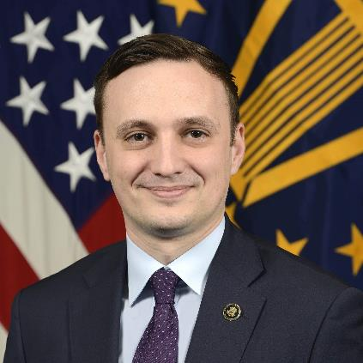
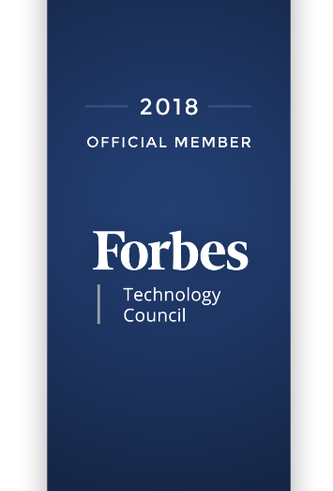
Nicolas Chaillan - Presenter
Nicolas M. Chaillan is the Chief Software Officer at the U.S. Air Force and the Co-Lead for the DoD Enterprise DevSecOps Initiative.
He is the former Special Advisor for Cloud Security and DevSecOps at OSD, A&S.
He was the Special Advisor for Cybersecurity at the Department of Homeland Security and the Chief Architect for Cyber.gov, the new robust, innovative and holistic .Gov cyber security architecture for all .gov agencies.
Chaillan is a technology entrepreneur, software developer, cyber expert and inventor. He is recognized as one of France’s youngest entrepreneurs after founding his first company at 15 years of age.
With 19 years of international tech, entrepreneurial and management experience, Chaillan is the founder of more than 12 companies, including AFTER-MOUSE.COM, Prevent-Breach, anyGuest.com, and more.
Over the last eight years alone, he has created and sold over 180 innovative software products to 40 Fortune 500 companies.
Chaillan is recognized as a pioneer of the computer language PHP.
Chief Software Officer

Slide 37
Thank You!
Nicolas Chaillan
Chief Software Officer, U.S. Air Force
nicolas.m.chaillan.civ@mail.mil

